Slide 1

Your past, your present and your future

Slide 2


Slide 3
Overview
Idea
Technologies
Competitors
Costs
Team
Planification
Demo
Piloting plan

Slide 4
IDEA
What is Capsulefy?

Slide 5





Time capsule

Slide 6


Payment plans
 | Free | Premium
Price | 0 € | 11.99 €
Storage | 20 MB/user | 500 MB/capsule
Social network and email integration
Capsule scheduling | 1 year | No limit
Capsule expiration | 6 months after release | No expiration
Modular and private capsules

Slide 7
TECHNOLOGIES
What stack do we use?

Slide 8




Web app
Users and capsules
Media storage
Social network

Slide 9





Slide 10
Travis CI builds
All branches |  |  | Master
Passed | Failed | Cancelled | Passed | Failed | Cancelled
361 | 104 | 42 | 23 | 14 | 2
Total: 507 |  |  | Total: 39

Slide 11



Code coverage
0
50
75
85
100
!
~
Before sprint 3, week 1: 42 %
After sprint 3, week 1: 78 %

Slide 12
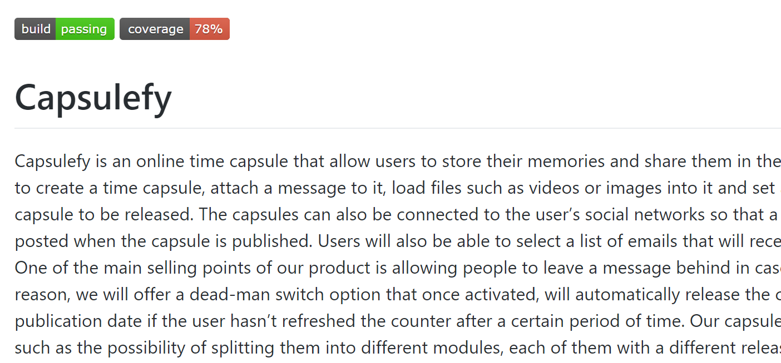

Slide 13

Release naming
1 | Devising a project
2 | Sprint 1
3 | Sprint 2
4 | Sprint 3
…
Release X
X =

Slide 14
URL naming
1 | Landing page
2 | Sprint 1
3 | Sprint 2
4 | Sprint 3
capsulefy0X
.herokuapp.com
X =

Slide 15
COMPETITORS
What makes us different?

Slide 16
 | Viajeros en el tiempo | Mytimecapsule | Miigen | thetimecapsule | Capsulefy
Automatic content publication
Free plan
Premium plan
Images
Videos
Social network integration
Deadman switch

Slide 17
COSTS
How much does Capsulefy cost?

Slide 18
Project duration | 4 months
Salaries | 20.80 €/hour
Hours per month | 40
Amortization | 60 months
Equipment | 306 €
Hosting (1 year) | 669 €
Advertising (6 months) | 3060 €
Customer support (1 year) | 15000 €
Risk prevention | 10% (2724 €)
Total | 44968 €

Slide 19
TEAM
Who is behind?

Slide 20
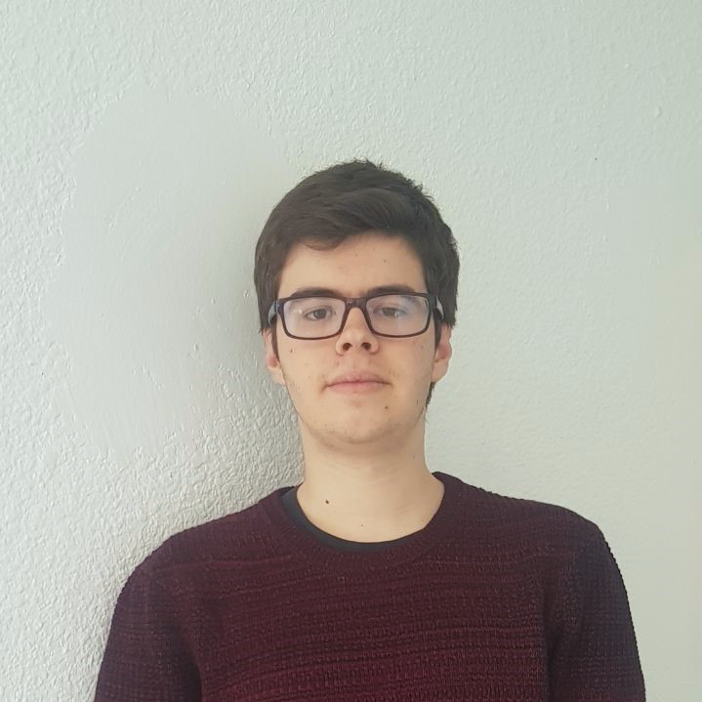
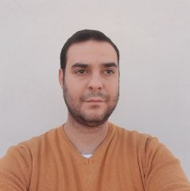




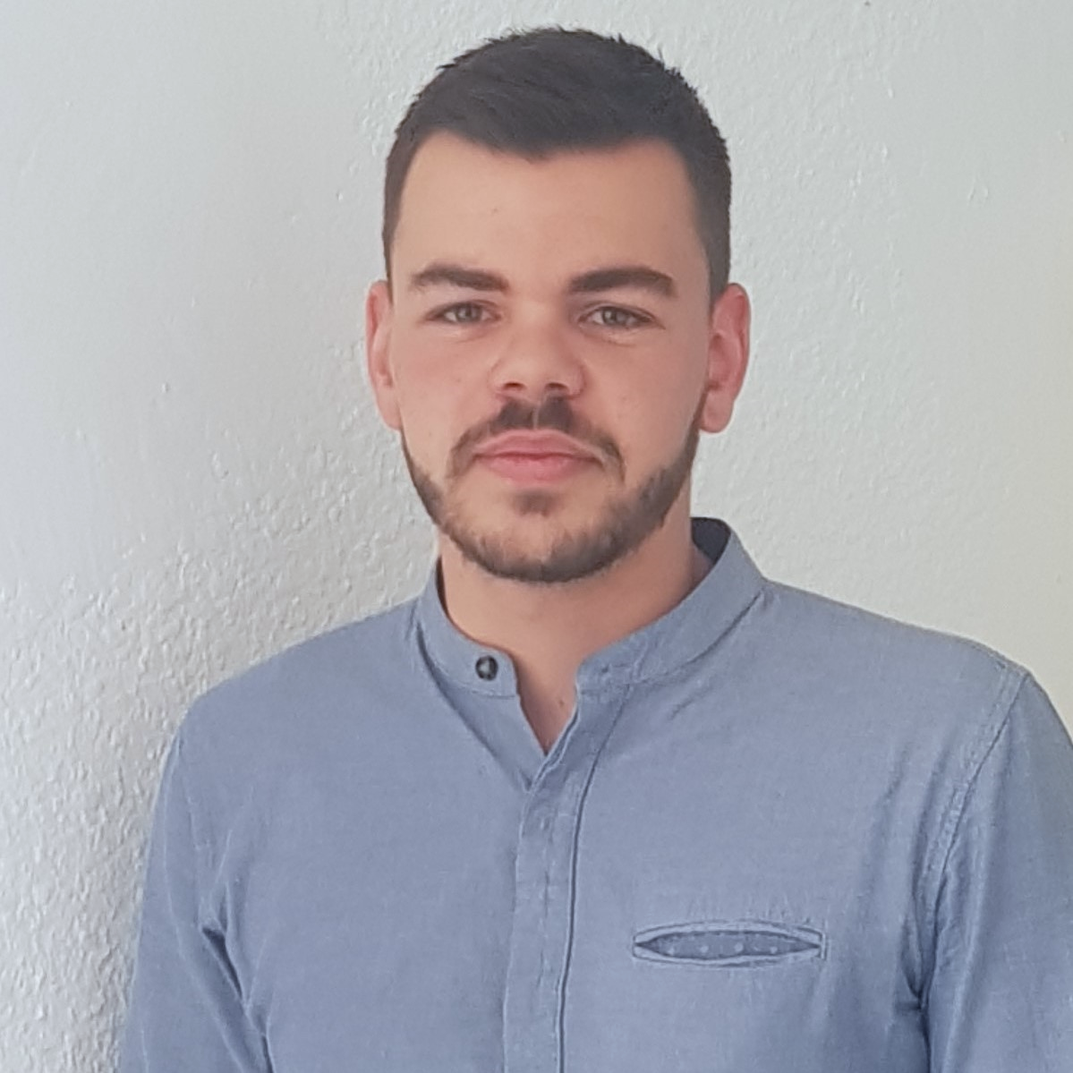
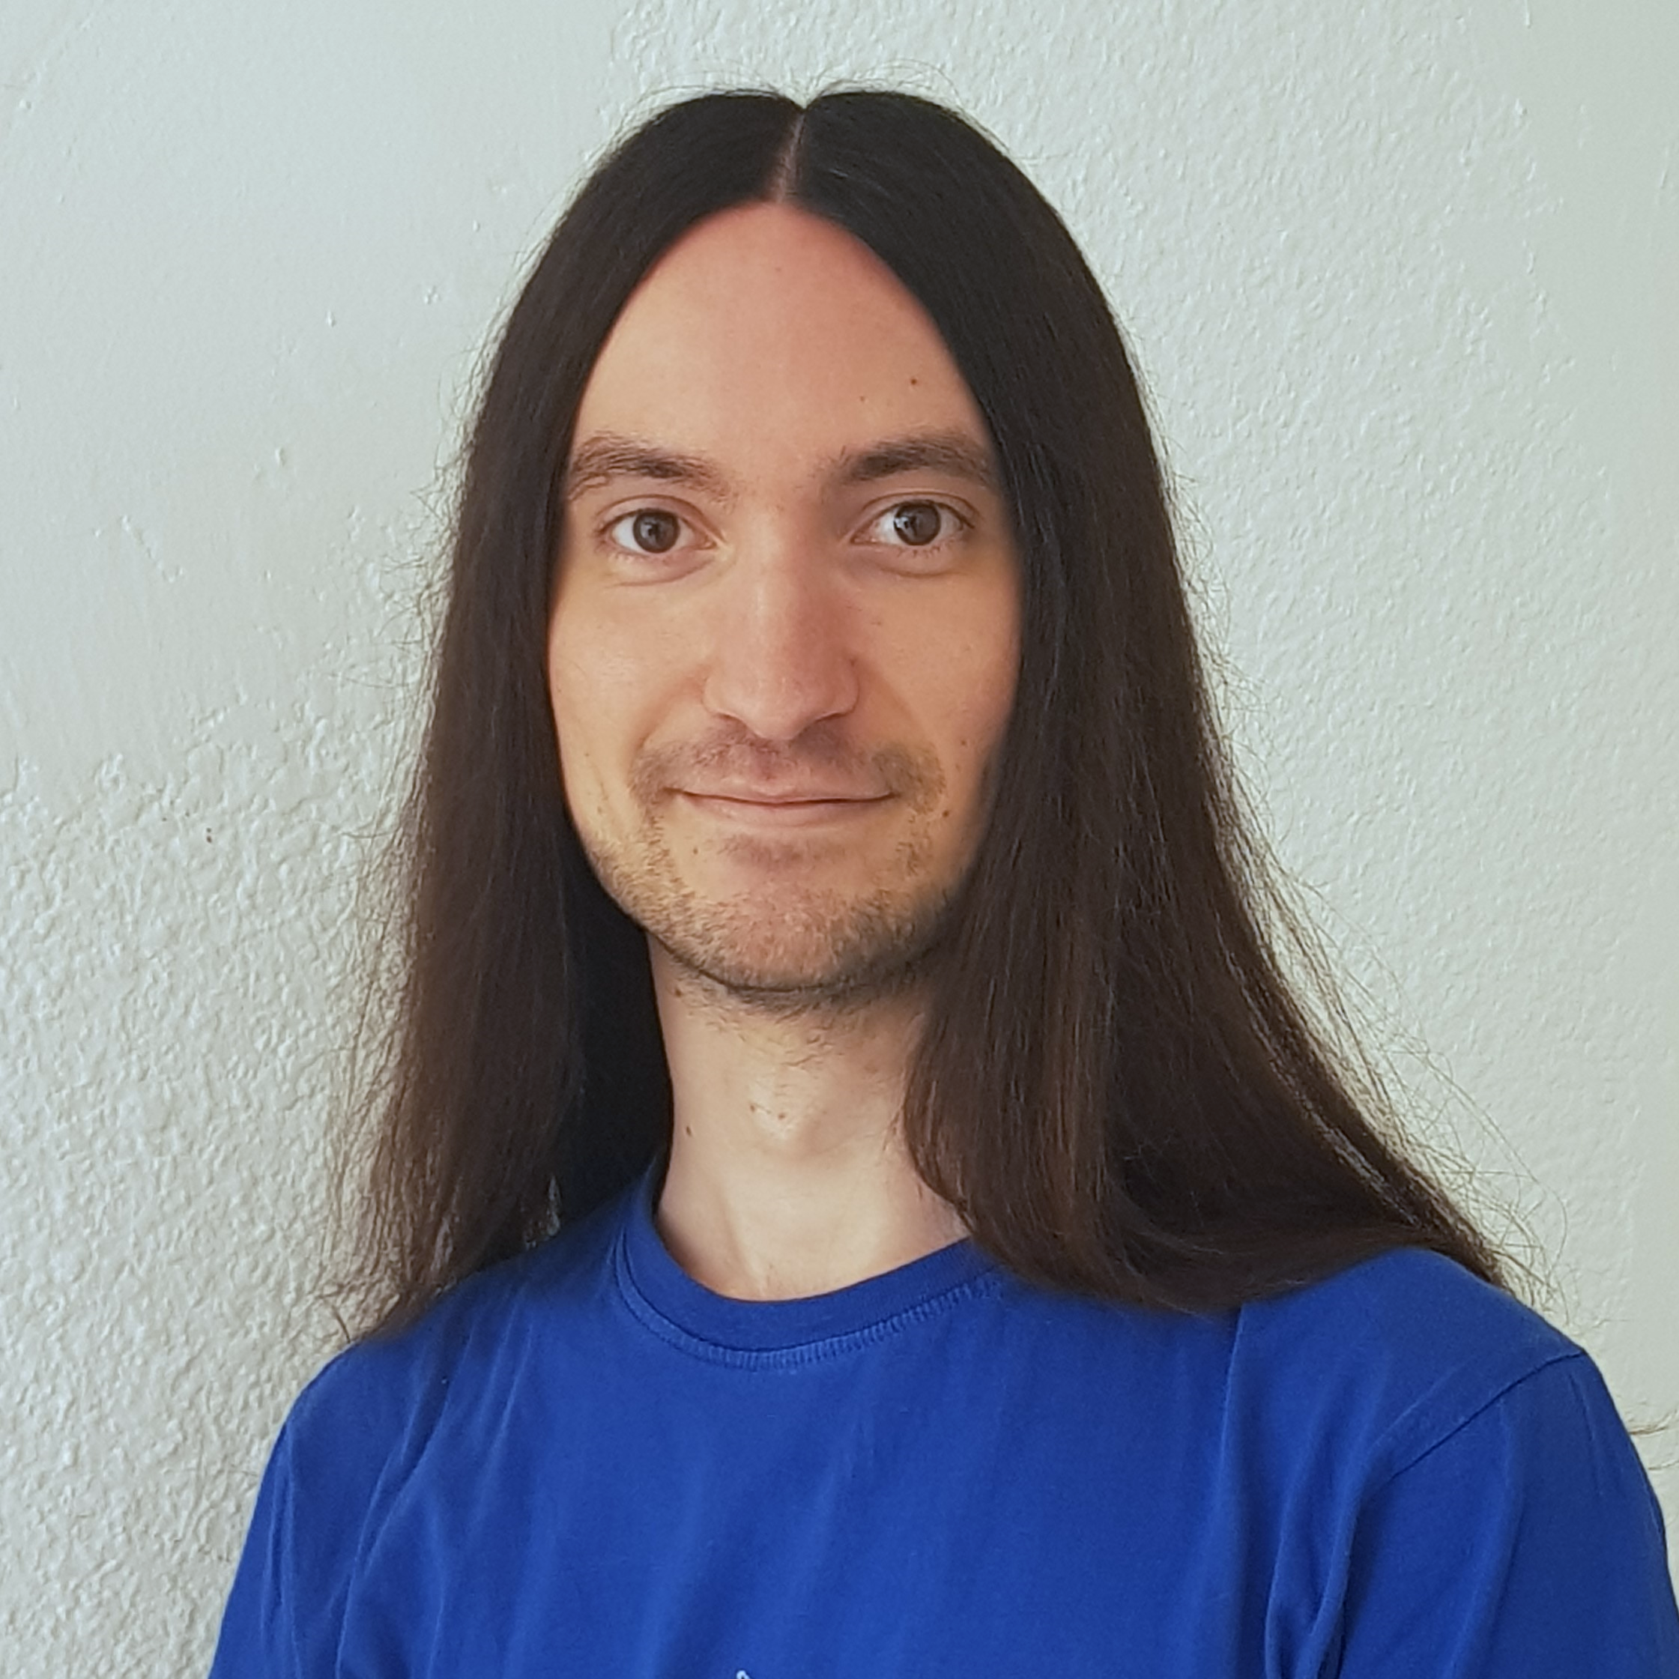


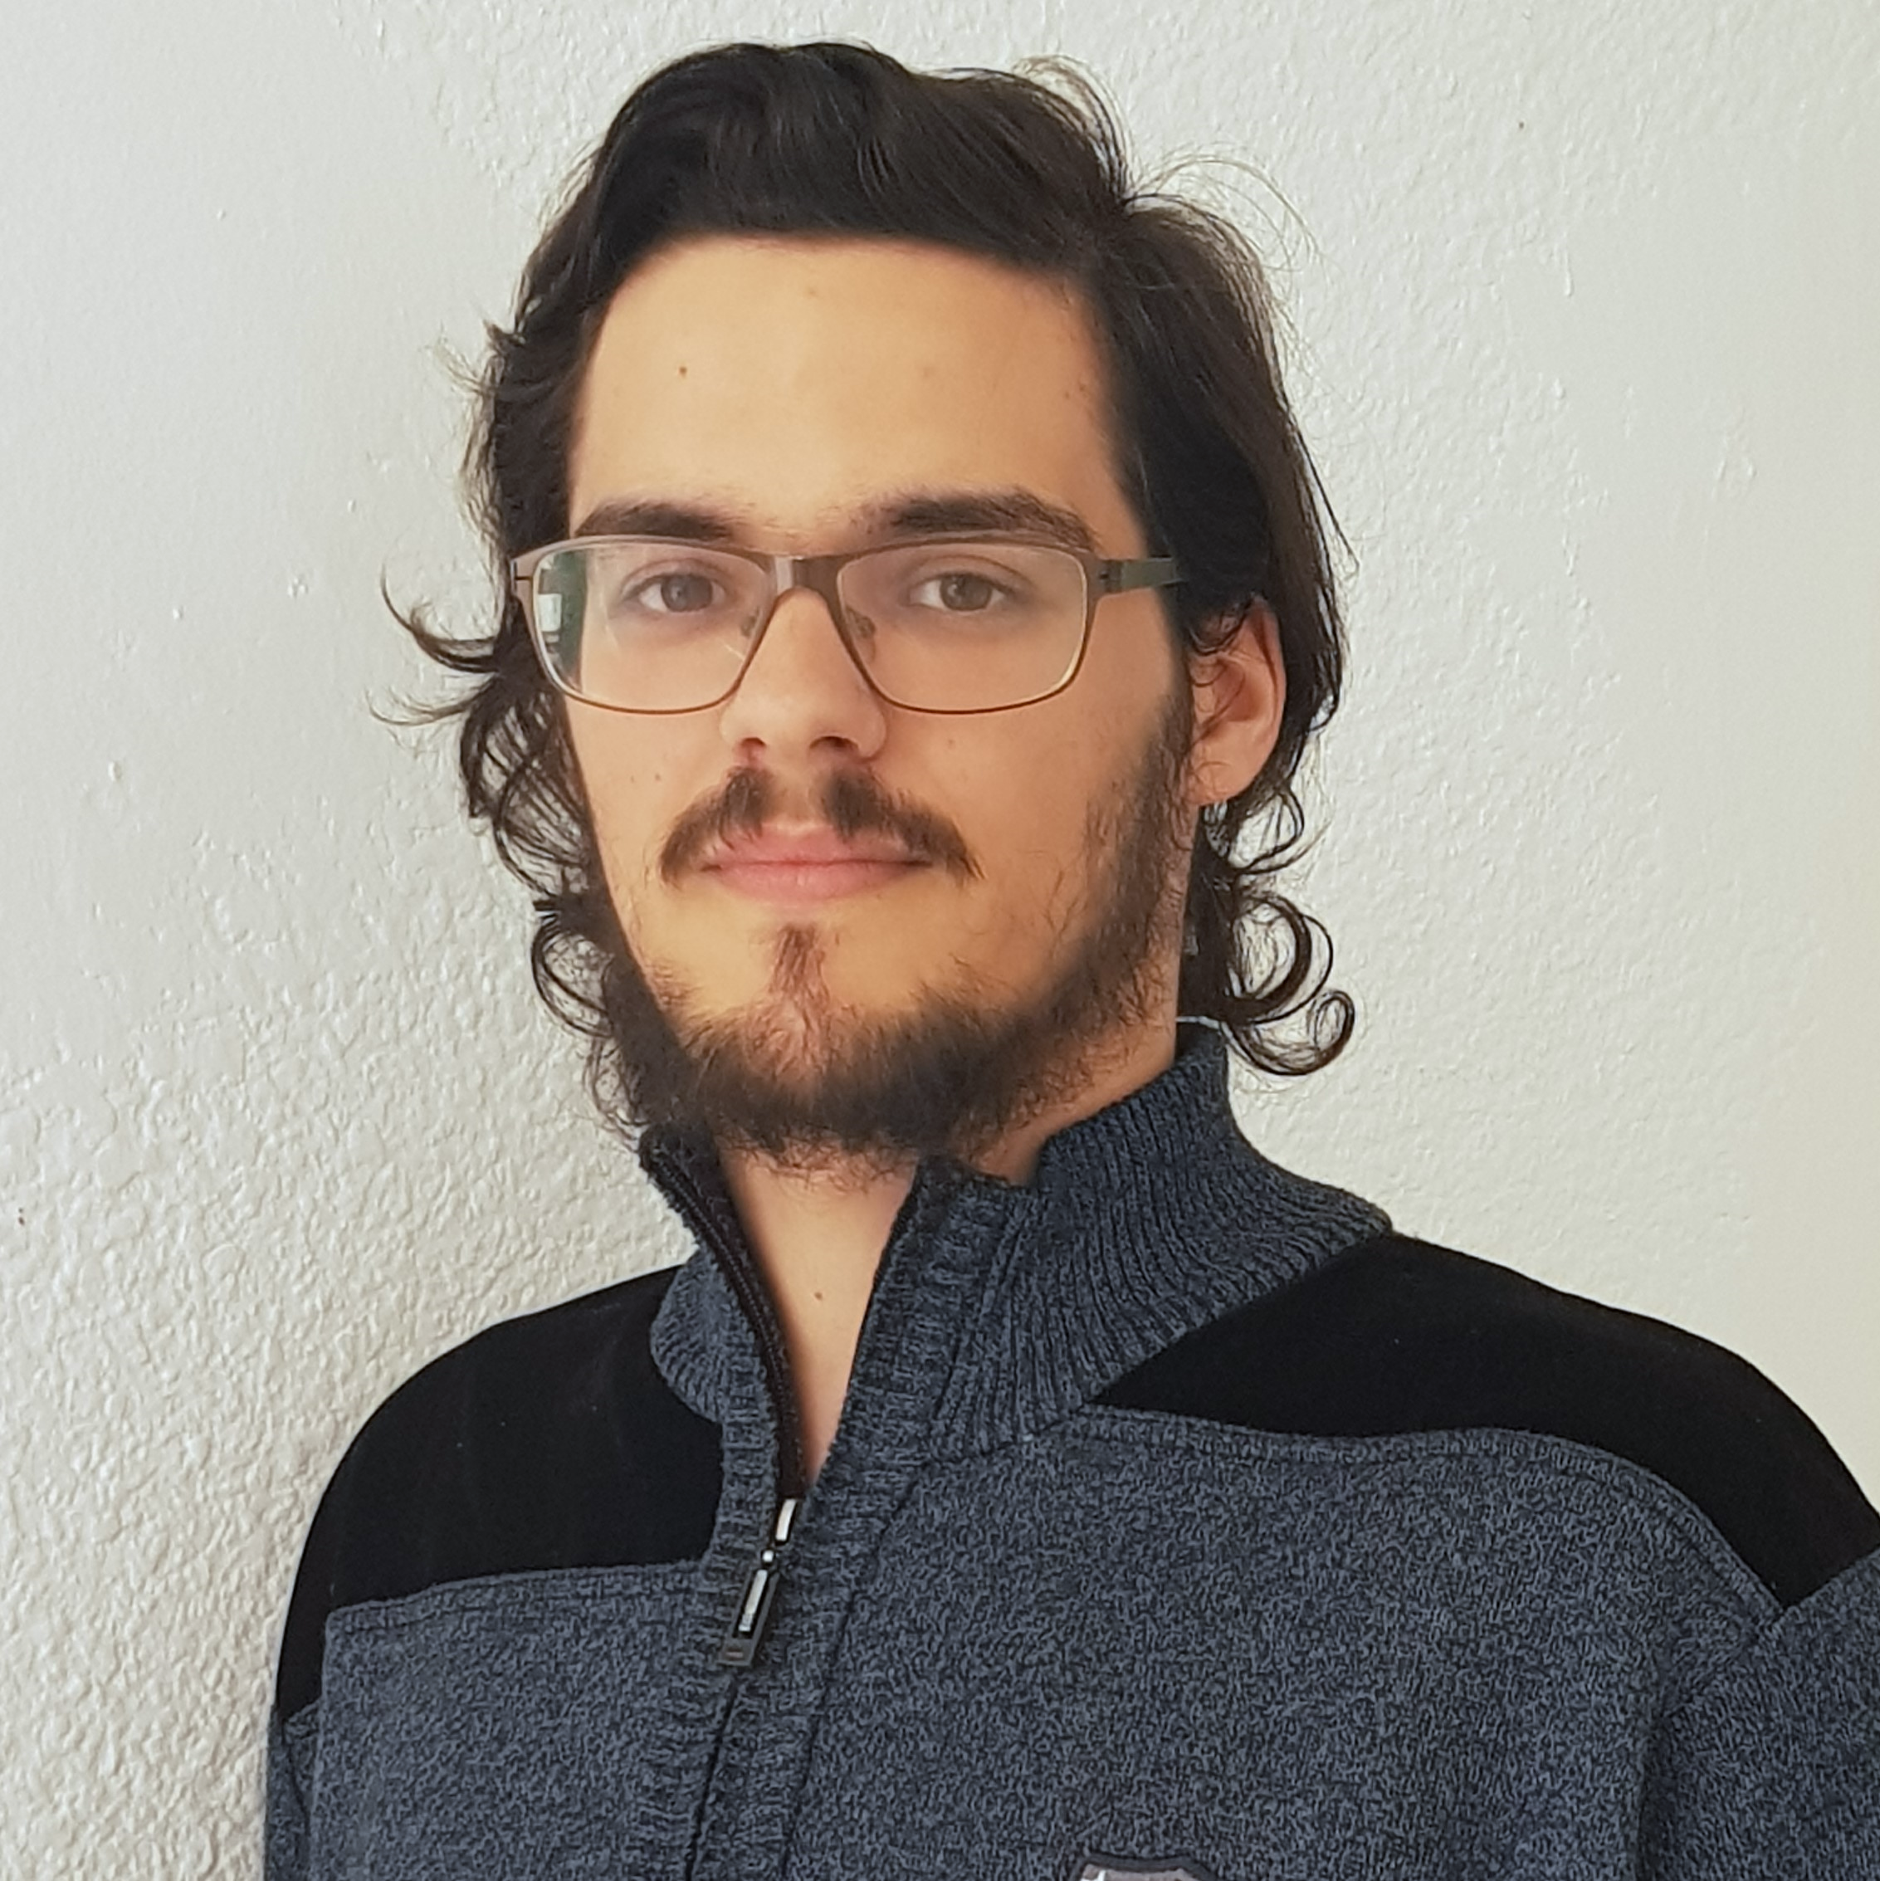



Pablo Rebollo
Project manager, backend developer
Juan Rodríguez
Requirements engineer, backend developer
Adrián Cantón
Business manager, full-stack developer
Rafael Fresno
Backend developer, API integration
Daniel Carpio
Analist,
frontend developer

Slide 21
PLANIFICATION
How do we organize development?

Slide 22
First sprint March 18th – March 29th | Core use cases Piloting plan
Second sprint April 1st – April 12th | Full MVP Feedback taken into account
Third sprint April 22nd – May 3rd | Polished MVP

Slide 23


Performance indicator
$$avg(\frac{Estimated time}{Invested time})$$
0.5
0.8
1.2
1.5
!
~
?

Slide 24
PM performance indicator
$$PMP∗avg\left(MP\right)−TD∗0.1$$
PMP: Project Manager performance
MP: Members performance
TD: Total task delays (days)
0.5
1.5
!
~
?

Slide 25

Relative performance indicator
$$\frac{avg(This week performance)}{avg(Last week performance}$$
0.5
0.8
1.2
1.5
!
~
?

Slide 26



Factors affecting performance
Optimistic estimation
Wasted time
Difficulties
Pesimistic estimation
Easier tasks
Unknown technology

Slide 27



General solutions
Talk
Reschedule
Balance
Monitor

Slide 28
SPRINT 3 WEEK 1
April 22nd – April 28th

Slide 29
 |  | April
Task | Assignees | 22 | 23 | 24 | 25 | 26 | 27 | 28
Initial meeting | All
Improve checkboxes | Daniel
Coverage tests | Rafael
Unit tests | Adrián
Improve responsive | Daniel
Improve demo videos | Adrián
Add date picker | Juan
Fix sign up message | Juan

Slide 30
 |  | April
Task | Assignees | 22 | 23 | 24 | 25 | 26 | 27 | 28
Update costs | Pablo
GDPR | Pablo
Improve return button | Daniel
Improve 404 pages | Daniel
Improve email inputs | Daniel
Landing page content | Juan
Fix image proportions | Daniel
Test automation results | Pablo

Slide 31
 |  | April
Task | Assignees | 22 | 23 | 24 | 25 | 26 | 27 | 28
Improve dashboard | Juan
Review populate | Pablo
Presentation | Rafael
Advertisement video | Pablo
Rehearsal | Pablo

Slide 32
Performance
Pablo (PM) | 1.09
Daniel | 0.88
Rafael | 0.93
Adrián | 0.83
Juan | 1.1

Slide 33
Relative performance
This week | 0.96
Last week | 1.28
Result | 0.75

Slide 34
Project duration | 10 weeks (5 development)
Total salaries | 9797 €
Amortization | 60 months
Equipment | 265 €
Hosting and advertising | 0 €
Customer support | 15000 €
Risk prevention | 2724 €
Total | 9455 €
Project completion | 66 %
Spent budget | 61 %

Slide 35


What went wrong?
- What happened?
Two tasks had some delays.
- Solution
The PM will pay more
attention to task progress.
Task delays

Slide 36

What went wrong?
- Measure
Greatest delay in week 2 (days)
!
Task delays
2
3

Slide 37





What went wrong?
- What happened?
Creating a Facebook dev
account was not easy.
- Solution
Assign more people.
Facebook integration

Slide 38
What went wrong?
- Measure
Task completion in week 2 (%)
!
Facebook integration
50
75

Slide 39

Measures
Performance ratio
!
~
?
0.5
0.8
1.2
1.5
Divide tasks
W1 lowest performance: 0.83

Slide 40
Measures
Delay (days)
!
2
3
Divide tasks
W1 greatest delay: 1

Slide 41

Measures
Invested hours
!
6
7
Divide tasks
W1 task with most hours: 6

Slide 42

Measures
Invested days
!
6
7
Divide tasks
W1 task with most days: 4

Slide 43

Measures
Wiki entries
!
3
4
Better
tool usage
Wiki entries after W1: 6

Slide 44
DEMO
How does the system look like?

Slide 45
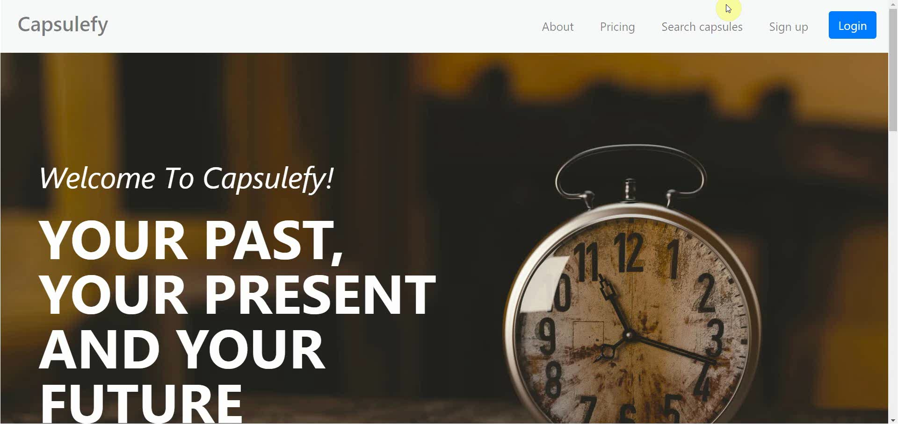
No logged user – List, search and display capsules

Slide 46

No logged user – Sign up

Slide 47
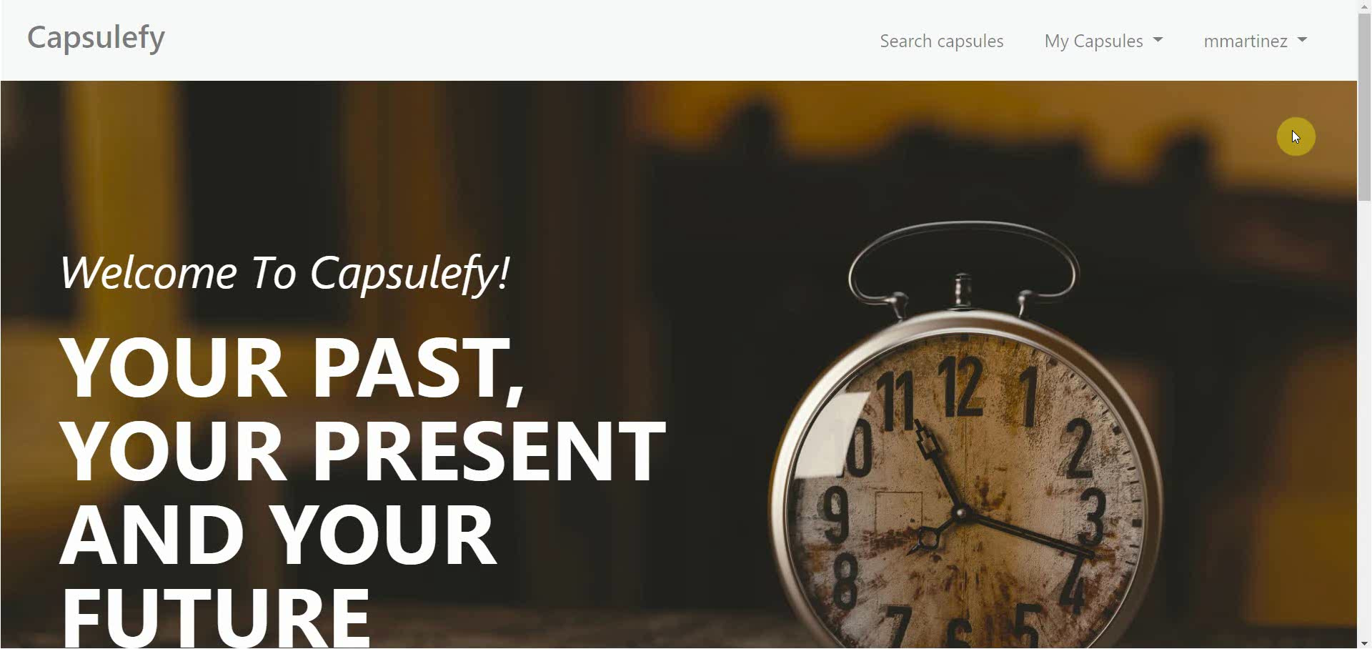
Logged-in user – My account

Slide 48
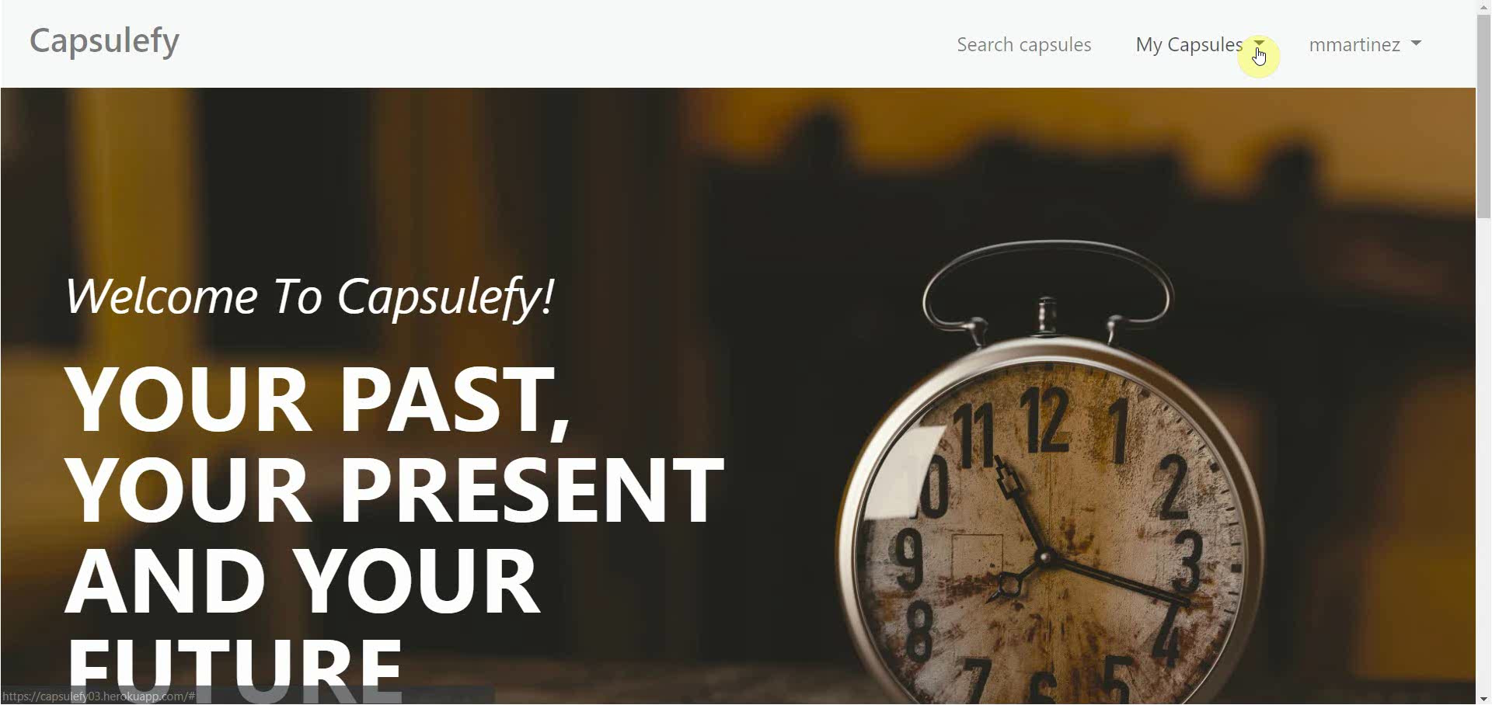
Logged-in user – Modular capsules

Slide 49

Logged-in user – Edit capsules

Slide 50
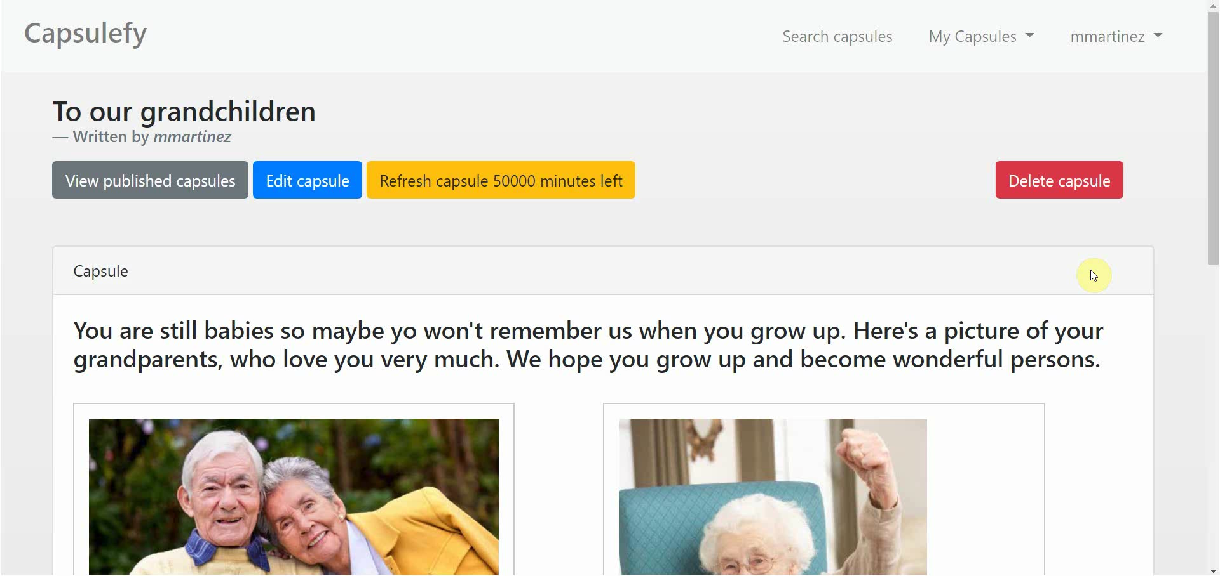
Logged-in user – Delete modules

Slide 51
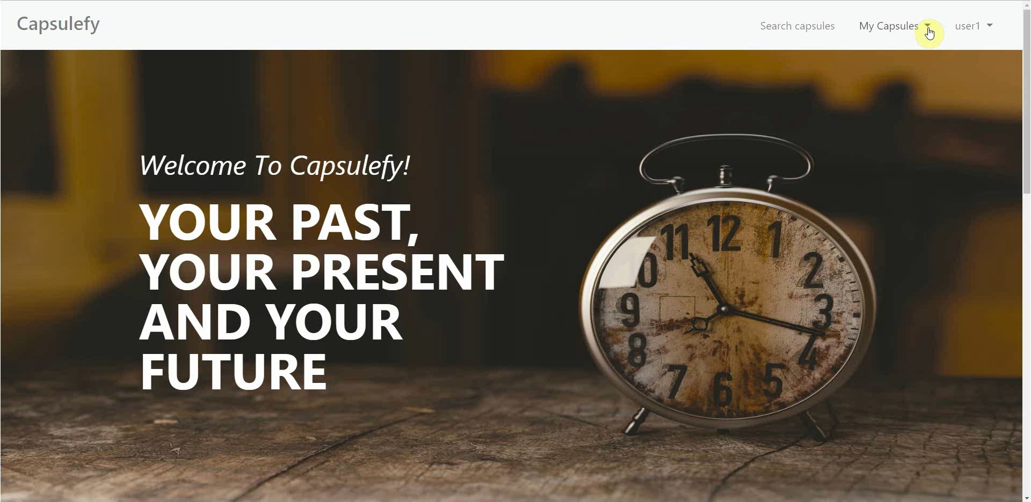
Logged-in user – Refresh timer

Slide 52
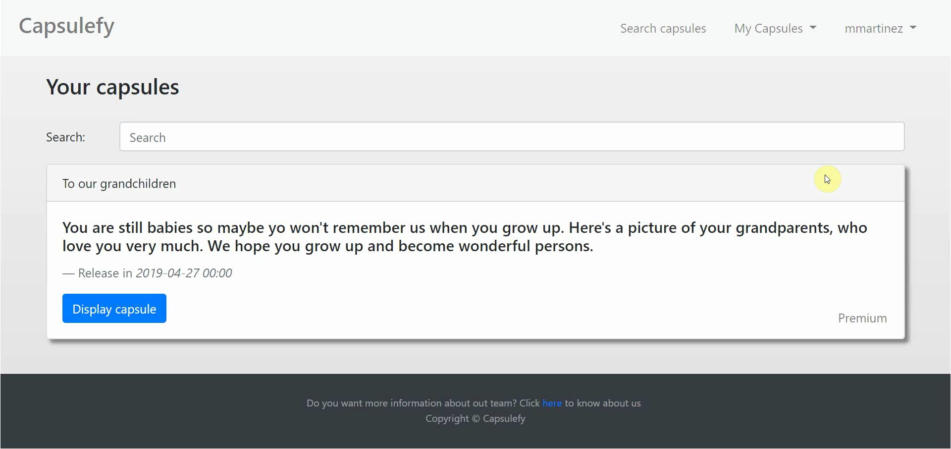
Logged-in user user – Delete capsules

Slide 53
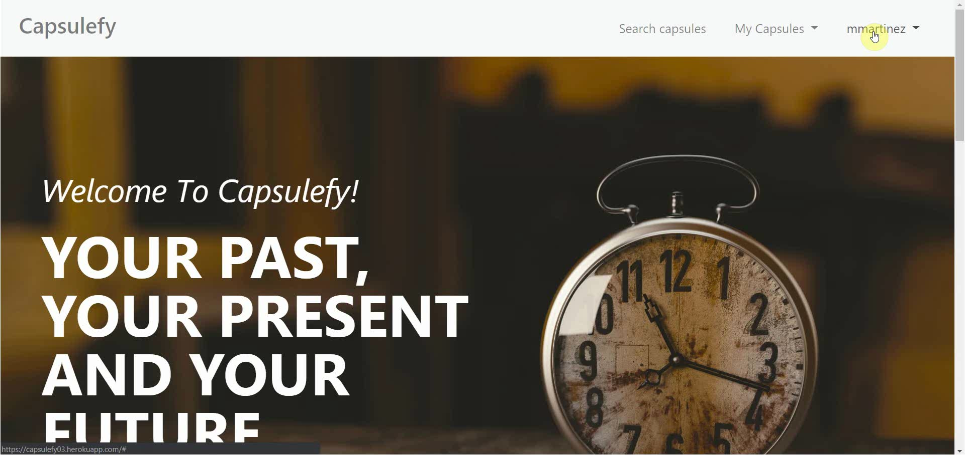
Logged-in user – Delete user data

Slide 54

Admin – List and ban users

Slide 55
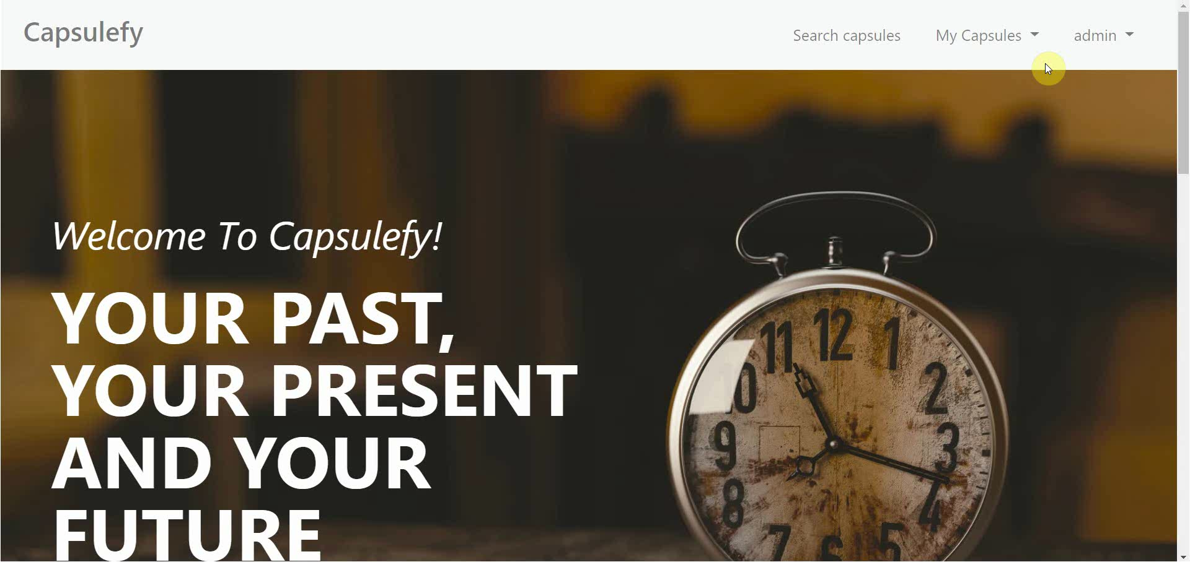
Admin – Dashboard

Slide 56
SPRINT 3 WEEK 2
April 29th – May 3rd

Slide 57
 |  | April |  | May
Task | Assignees | 29 | 30 | 1 | 2 | 3
Feedback meeting | All
Favicon and frontend | Daniel
Name inconsistencies | Adrián
Password restrictions | Juan
Facebook integration | Rafael, Pablo
Review populate | Juan
Deploy app | Adrián
Test app | Daniel, Juan

Slide 58
 |  | April |  | May
Task | Assignees | 29 | 30 | 1 | 2 | 3
Presentation | Rafael
Pilot users form | Pablo
User manual | Pablo
Sprint 3 retrospective doc | Pablo
Rehearsal | Pablo

Slide 59
Project launch
What tasks will we do?

Slide 60





- Finish Facebook integration
- Add creation date to capsules
- Receive new feedback from pilot users
- Advertisement campaign
- Final version of costs
- Final pricing
- Product presentation

Slide 61
PILOTING PLAN
How will users test Capsulefy?

Slide 62




Create manual
Create test suite
Test the system
Gather feedback
Fill form

Slide 63
Committed users
Name | Age
Francisco R. | 55
Javier A. | 19
Valentin A. | 19
Antonio G. | 26
José Manuel J. | 21
Name | Age
Sandra C. | 28
José Manuel C. | 21
Rafael C. | 55
Antonio C. | 54
Auxiliadora L. | 50

Slide 64
Sprint 2
Users receive and fill form
March 30 – April 6
Development
April 8 – April 12
Receive users feedback
April 6
Planification
April 8

Slide 65
Sprint 3
Easter Week
Users receive and fill form
April 12 – April 22
Development
April 22 – May 3
Receive users feedback
April 22
Planification
April 22

Slide 66
second FEEDBACK RESULTS
What did users say?

Slide 67


How did we prioritize?
Depending on:
- Implementation difficulty
- How many users asked for it

Slide 68

“It would be interesting to see the creation and publication dates”

Slide 69


Frontend improvements
Solution
Status
Add creation date (requires model change)
To be determined
Due to backend changes
?
Priority: low

Slide 70
“Passwords should require a minimum length and some special characters”

Slide 71

Password validation
Solution
Status
Add password restrictions
Scheduled
For sprint 3, week 2
***
Priority: medium

Slide 72
“It would be nice to be able to share capsules in Facebook”

Slide 73
Facebook integration
Solution
Status
Add Facebook integration
To be determined
Due to several difficulties
?
Priority: high

Slide 74
“When registering, a date picker for the birthdate would be appreciated”

Slide 75

Frontend improvements
Solution
Status
Add date picker for birthdate
Done
During sprint 3, week 1
Priority: medium

Slide 76
“There is no favicon and some contextual help would be great”

Slide 77

Frontend improvements
Solution
Status
Add favicon and more helpful icons
Scheduled
For sprint 3, week 2
Priority: low

Slide 78
“Some names are different when creating and displaying capsules”

Slide 79
Frontend improvements
Solution
Status
Review and fix inconsistent names
Scheduled
For sprint 3, week 2
abc
Priority: medium

Slide 80
After development
Users receive and fill form
May 4 – May 12
Receive users feedback
May 12
Planification
May 13

Slide 81
Documentation
Manual (PDF)
Test suite
Form
https://forms.gle/NmN7pxV28oh9hCcV6

Slide 82
Thanks!
Upstream: https://capsulefy.herokuapp.com
Sprint 2: https://capsulefy03.herokuapp.com
Landing page: https://capsulefy01.herokuapp.com
Contact email: capsulefy.communications@gmail.com
Pilot users form: https://forms.gle/https://forms.gle/NmN7pxV28oh9hCcV6
GitHub releases: https://github.com/pabreblob/capsulefy/releases

Slide 83


Deadman switch
ON

Slide 84



Teamwork
Skills
Profitable work
Positive feedback

Slide 85
Realistic | 44968 – 46330 €
Optimistic | 43061 €
Pesimistic | 49054 €
Project duration: 4 months

Slide 86

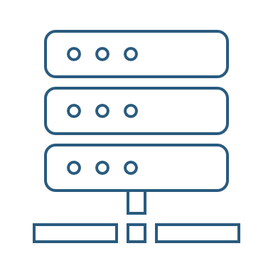

Risk | Mitigation
Broken computer | Risk prevention funds
Changing terms of use | Monitor
Servers down | Monitor
Incompatible timetables | Reschedule

Slide 87
Year 1: 2000 sales
Balance: -10168 €
Year 2: 4000 sales
Balance: 16273 €
29968 €
39600 €
19800 €
13159 €
Costs
Earnings
Costs
Earnings

Slide 88
Year 3: 8000 sales
Balance: 81450 €
79200 €
14023 €
Costs
Earnings

Slide 89

Monthly advertising costs
220 €
140 €
150 €

Slide 90
SPRINT 1 WEEK 1
March 18th – March 22nd

Slide 91
Task | Assignees | Est. (h) | Inv. (h) | Status
Data model | Adrián, Daniel | 4 | 1.5 | Finished
Set up environment | All | 2.5 | 2.5 | Finished
Angular research | Daniel | 1 | 2 | Aborted
Data model implementation | Juan | 2.5 | 2 | Finished
Populate database | Pablo | 2 | 3.2 | Finished
Basic capsule CRUD | Rafael | 2.5 | 9 | To be tested
Display capsules | Adrián | 2 | 5 | To be tested
TIME

Slide 92
Task | Assignees | Est. (h) | Inv. (h) | Status
Listing capsules | Juan | 1.5 | 1 | To be tested
User login | Juan | 1 | 1 | To be tested
Advertisement budget | Pablo | 1.5 | 1.5 | Finished
User interface | Daniel | 1 | 10 | Finished
Documentation | Daniel, Adrián, Juan | 1.5 | 1.5 | Finished
Presentation | Pablo, Rafael | 3 | 4 | Finished
Review meeting | All | 2.5 | 2.5 | Finished
TIME

Slide 93
Performance
Adrián | 1.34
Daniel | 1.05
Rafael | 0.67
Pablo | 0.84
Juan | 1.06

Slide 94


What went wrong?
No Angular knowledge
Bad estimations
Lack of time

Slide 95
SPRINT 1 WEEK 2
March 25th – March 29th

Slide 96
Task | Assignees | Est. (h) | Inv. (h) | Status
Feedback meeting | All | 5 | 5 | Finished
Travis CI set up | Adrián, Rafael | 2 | 3 | Finished
Modular capsules | Adrián | 5 | 4.5 | Finished
Private capsules | Juan | 2 | 1.5 | Finished
Email automation | Juan | 2 | 1.5 | Finished
Search capsules | Daniel | 1.5 | 1 | Finished
List own capsules | Juan | 1 | 1 | Finished
Pagination | Juan | 1 | 3 | Finished
TIME

Slide 97
Task | Assignees | Est. (h) | Inv. (h) | Status
Deadman switch | Pablo | 4 | 5 | Finished
Social network integration | Rafael | 4 | 1 | Postponed
User interface | Daniel | 4 | 7 | Finished
Piloting plan | Adrián | 2.5 | 1 | Finished
Sprint meeting | All | 5 | 5 | Finished
Documentation | Adrián, Daniel, Juan | 1.5 | 1.5 | Finished
Presentation | Rafael | 3 | 5.5 | Finished
Deliverable | Pablo | 3 | 4 | Finished
TIME

Slide 98
Performance
Adrián | 1.32
Daniel | 1.03
Rafael | 0.60
Pablo | 0.77
Juan | 0.87

Slide 99
What went wrong?
Performance further reduced
Implementation differences
Lack of time

Slide 100
What actions were taken?
Meet
Reschedule
Reestimate

Slide 101
Total performance
Adrián | 1.31
Daniel | 1.02
Rafael | 0.63
Pablo | 0.80
Juan | 0.96

Slide 102

Taken actions
Detailed planning
Time for documentation
Better tool usage
Divide tasks

Slide 103
SPRINT 1 RESULTS
What was produced?

Slide 104
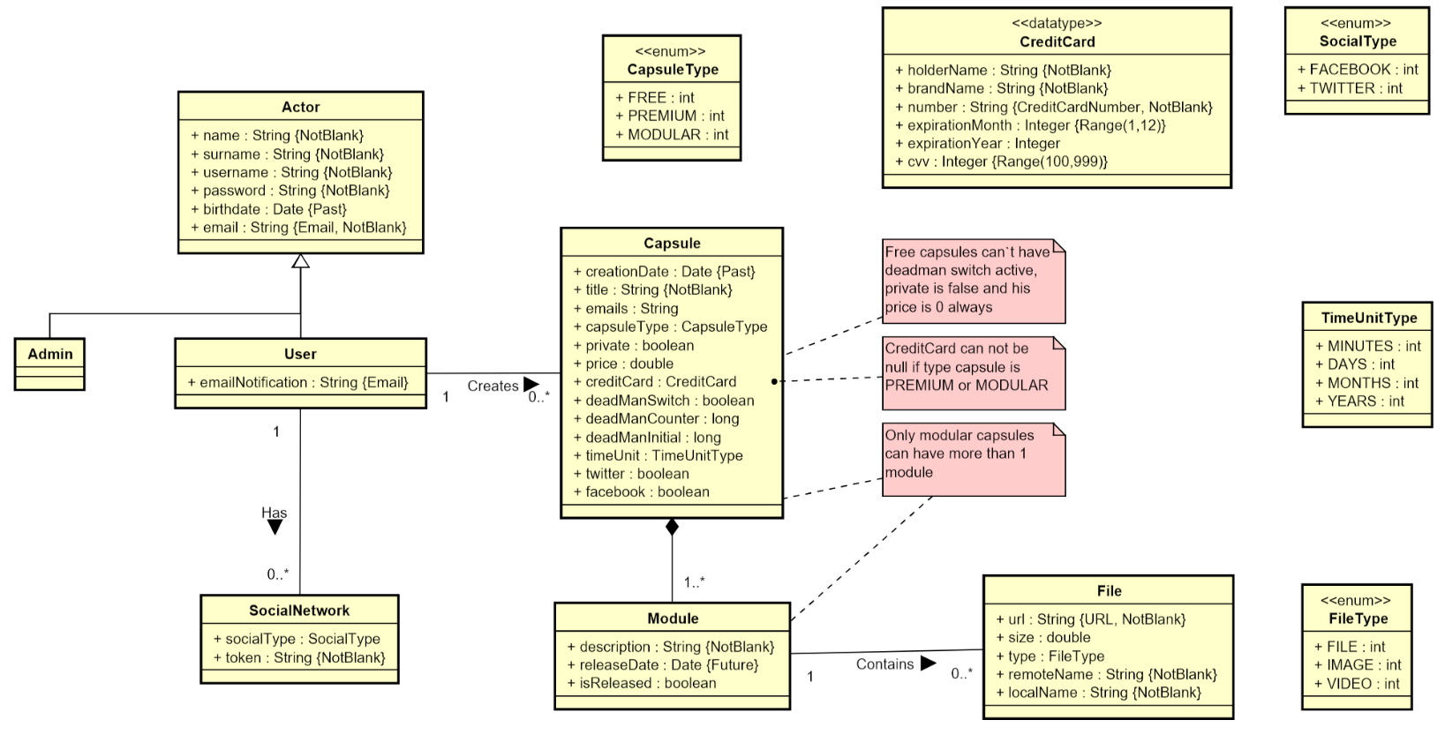

Slide 105
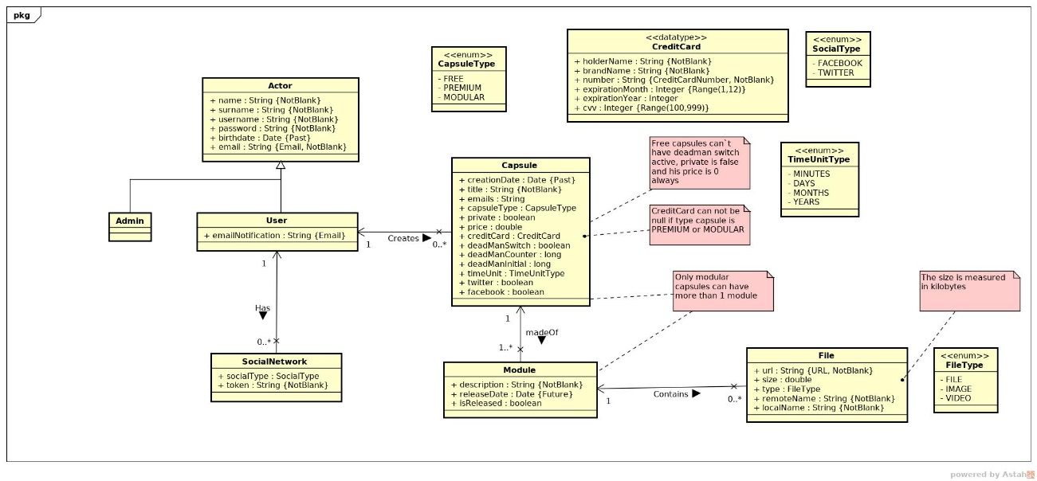

Slide 106
Documentation
Sprint 1 documentation
Piloting plan
Development
Frozen app: https://capsulefy02.herokuapp.com
GitHub release: https://github.com/pabreblob/capsulefy/releases

Slide 107
Project duration | 7 weeks (2 development)
Salaries | 20.80 €/hour
Hours per month | 40
Total salaries | 6989 €
Amortization | 60 months
Equipment | 134.16 €
Hosting | 0 €
Advertising | 0 €
Total | 7123.16 €

Slide 108
Quality (p) | MB/minute
144 | 1.3
240 | 3.3
360 | 5
480 | 8.3
720 | 25
1080 | 50

Slide 109
SPRINT 2 WEEK 1
April 1st – April 7th

Slide 110
 |  | April
Task | Assignees | 1 | 2 | 3 | 4 | 5 | 6 | 7
Initial meeting | All
Local settings | Daniel
User registration | Juan
Remove expired capsules | Pablo
Twitter integration | Rafael
Update modular form | Adrián
Fix pagination issues | Juan
DM email notifications | Pablo

Slide 111
 |  | April
Task | Assignees | 1 | 2 | 3 | 4 | 5 | 6 | 7
UI: Registration | Daniel
Ban users | Juan
UI: User account | Daniel
Automations | Pablo
Basic payment | Adrián
Presentation | Rafael
UI: List and search users | Daniel
Rehearsal | Pablo

Slide 112
Unplanned tasks
Task | Assignees | Invested time (h)
Travis test problems | Daniel | 1.5
Check DM switch when editing capsules | Daniel | 0.25
Fix AJAX search | Juan | 0.5
Add tooltip for notification emails | Daniel | 1
Improve registration form | Juan | 2

Slide 113
Performance
Pablo (PM) | 0.93
Daniel | 1.44
Rafael | 1
Adrián | 0.94
Juan | 1.08

Slide 114
Sprint 1 problem
Bad estimations
Solution:
Divide tasks

Slide 115
Measures
Performance ratio
!
~
?
0.5
0.8
1.2
1.5
Divide tasks
W1 lowest performance: 0.93

Slide 116

Measures
Delay (days)
2
Divide tasks
W1 greatest delay: 2

Slide 117
Measures
Invested hours
6
Divide tasks
W1 task with most hours: 6

Slide 118
Measures
Invested days
6
Divide tasks
W1 task with most days: 5

Slide 119
Sprint 1 problem
Poor tool usage
Solution:
Better tool usage

Slide 120
Measures
Wiki entries
~4
Better
tool usage
Wiki entries after W1: 5

Slide 121
What went wrong?
- What happened?
Django 2.2 broke our tests.
- Solution
Migrate to Django 2.2 and fix
all tests.
Django update

Slide 122
What went wrong?
- Measure
Number of failing tests
Django update
0
Number after W1: 0

Slide 123


What went wrong?
- What happened?
Late deployment led to many
errors.
- Solution
Deploy 2 days before deadline.
Deployment
problems

Slide 124
What went wrong?
- Measure
Days before deadline
Deployment
problems
2
Days in W1: 0

Slide 125
Project duration | 8 weeks (3 development)
Salaries | 20.80 €/hour
Hours per month | 40
Total salaries | 8207 €
Amortization | 60 months
Equipment | 200 €
Hosting | 0 €
Advertising | 0 €
Total | 8407 €

Slide 126
Task | Assign. | Start | End | Est. (h) | Inv. (h)
Initial meeting | All | Apr 1 | Apr 1 | 1.5 | 1.5
Local settings | Daniel | Apr 2 | Apr 2 | 1 | 0.5
User registration | Juan | Apr 2 | Apr 2 | 2 | 2
Remove expired capsules | Pablo | Apr 2 | Apr 2 | 1.5 | 1.5
Twitter integration | Rafael | Apr 2 | Apr 4 | 4 | 4
Update modular form | Adrián | Apr 2 | Apr 3 | 5 | 6
Fix pagination issues | Juan | Apr 3 | Apr 3 | 1.5 | 1.5
DM switch notifications | Pablo | Apr 3 | Apr 4 | 1.5 | 2
UI: Registration | Daniel | Apr 3 | Apr 4 | 0.5 | 0.25
TIME

Slide 127
Task | Assign. | Start | End | Est. (h) | Inv. (h)
Ban users | Juan | Apr 4 | Apr 6 | 2 | 1.5
UI: User account | Daniel | Apr 4 | Apr 6 | 1.5 | 1.25
Automation improvements | Pablo | Apr 4 | Apr 7 | 4 | 4.5
Basic payment | Adrián | Apr 5 | Apr 7 | 4 | 4
Presentation | Rafael | Apr 5 | Apr 7 | 3 | 3
UI: List and search users | Daniel | Apr 6 | Apr 7 | 2 | 2
Rehearsal | Pablo | Apr 7 | Apr 7 | 1.5 | 1
TIME

Slide 128
SPRINT 2 WEEK 2
April 8th – April 12th

Slide 129
 |  | April
Task | Assignees | 8 | 9 | 10 | 11 | 12
Feedback meeting | All
Fix functional tests | Adrián
Admin dashboard | Juan
Delete user data | Pablo
Add date picker | Adrián
Fix notification emails | Daniel
Add confirmation button | Daniel
Edit notifications emails | Rafael

Slide 130
 |  | April
Task | Assignees | 8 | 9 | 10 | 11 | 12
“About us” page | Daniel
Add return button | Daniel
Fix frontend errors | Daniel
Deploy app | Adrián
Test app | Daniel, Juan
Presentation | Rafael
Pilot users form | Pablo
User manual | Pablo

Slide 131
 |  | April
Task | Assignees | 8 | 9 | 10 | 11 | 12 | 20 | 21
Sprint 2 retrospective doc | Pablo
Rehearsal | Pablo

Slide 132
Unplanned tasks
Task | Assignees | Invested time (h)
Update populate | Pablo | 0.5
Fix capsule edition URL | Adrián | 0.25

Slide 133
Performance
Pablo (PM) | 1.23
Daniel | 1.9
Rafael | 0.96
Adrián | 1.33
Juan | 1

Slide 134
Measures
Performance ratio
!
~
?
0.5
0.8
1.2
1.5
Divide tasks
W2 lowest performance: 0.96

Slide 135
Measures
Delay (days)
2
Divide tasks
W2 greatest delay: 0

Slide 136
Measures
Invested hours
6
Divide tasks
W2 task with most hours: 5.5

Slide 137
Measures
Invested days
6
Divide tasks
W2 task with most days: 5

Slide 138
Measures
Wiki entries
~4
Better
tool usage
Wiki entries after W2: 5

Slide 139
What went wrong?
- Measure
Days before deadline
Deployment
problems
2
Days in W2: 2

Slide 140

What went wrong?
No problems during week 2!

Slide 141

Why?
- No complex tasks
- No technical problems
- Main frontend already developed

Slide 142


Delayed tasks
- Facebook integration
- Performance tests
- SonarCloud set up

Slide 143
Lessons learnt
Software updates
Monitor and test

Slide 144
Lessons learnt
Late deployment
Earlier deployments

Slide 145
Lessons learnt
No piloting plan feedback
Earlier feedback discussion

Slide 146

Lessons learnt
Changes affecting data
Review populate script

Slide 147
Lessons learnt
Higher performance
Better estimations

Slide 148


Lessons learnt
Bug tracking
GitHub issues ratios

Slide 149
GitHub issues ratios
- Bugs over new features
Current ratio: 8/128=0.06
- Time invested on bugs over time invested on new features

Slide 150
Project duration | 9 weeks (4 development)
Salaries | 20.80 €/hour
Hours per month | 40
Total salaries | 9217 €
Amortization | 60 months
Equipment | 238 €
Hosting | 0 €
Advertising | 0 €
Total | 9455 €

Slide 151
SPRINT 2 RESULTS
What was produced?

Slide 152
Documentation
Sprint 2 documentation
Updated user manual and pilot users form
Development
Frozen app: https://capsulefy03.herokuapp.com
GitHub release: https://github.com/pabreblob/capsulefy/releases

Slide 153
Task | Assign. | Start | End | Est. (h) | Inv. (h)
Feedback meeting | All | Apr 8 | Apr 8 | 1.5 | 1.5
Fix functional tests | Adrián | Apr 8 | Apr 10 | 0.75 | 0.5
Admin dashboard | Juan | Apr 8 | Apr 10 | 3 | 3
Delete user data | Pablo | Apr 8 | Apr 10 | 1.5 | 2
Add date picker | Adrián | Apr 8 | Apr 10 | 1 | 1
Fix notification emails | Daniel | Apr 8 | Apr 10 | 0.5 | 0.2
Add confirm button | Daniel | Apr 8 | Apr 10 | 1 | 0.4
Edit notification email | Rafael | Apr 8 | Apr 10 | 1 | 1
TIME

Slide 154
Task | Assign. | Start | End | Est. (h) | Inv. (h)
“About us” page | Daniel | Apr 8 | Apr 10 | 0.25 | 0.25
Add return button | Daniel | Apr 8 | Apr 10 | 1 | 0.25
Fix frontend errors | Daniel | Apr 8 | Apr 10 | 1.5 | 1.5
Deploy app | Adrián | Apr 10 | Apr 10 | 2 | 1.5
Test app | Daniel, Juan | Apr 10 | Apr 12 | 2 | 2
Presentation | Rafael | Apr 10 | Apr 12 | 5 | 5.5
Pilot user form | Pablo | Apr 8 | Apr 12 | 1.5 | 2
User manual | Pablo | Apr 8 | Apr 12 | 1 | 0.75
TIME

Slide 155
Task | Assign. | Start | End | Est. (h) | Inv. (h)
Sprint 2 retrospective doc | Pablo | Apr 8 | Apr 12 | 4 | 4
Rehearsal | Pablo | Apr 20 | Apr 21 | 1.5 | -
TIME

Slide 156
SPRINT 3 WEEK 1
April 22th – April 28th

Slide 157
Task | Assign. | Start | End | Est. (h) | Inv. (h)
Initial meeting | All | Apr 22 | Apr 22 | 1.5 | 1.5
Improve checkboxes | Daniel | Apr 22 | Apr 22 | 2 | 1.75
Coverage tests | Rafael | Apr 23 | Apr 23 | 1 | 1
Unit tests | Adrián | Apr 23 | Apr 24 | 5 | 6
Improve responsive | Daniel | Apr 23 | Apr 26 | 1 | 1
Improve demo videos | Adrián | Apr 23 | Apr 25 | 1 | 1
Add date picker | Juan | Apr 23 | Apr 24 | 0.5 | 0.5
Fix sign up message | Juan | Apr 24 | Apr 25 | 0.5 | 0.5
TIME

Slide 158
Task | Assign. | Start | End | Est. (h) | Inv. (h)
Update costs | Pablo | Apr 24 | Apr 25 | 1.5 | 1
GDPR | Pablo | Apr 24 | Apr 24 | 2 | 1.5
Improve return button | Daniel | Apr 24 | Apr 25 | 0.5 | 0.75
Improve 404 pages | Daniel | Apr 24 | Apr 25 | 0.5 | 0.5
Improve email inputs | Daniel | Apr 24 | Apr 24 | 1 | 1.25
Landing page content | Juan | Apr 24 | Apr 25 | 1.5 | 1
Fix image proportions | Daniel | Apr 24 | Apr 25 | 0.5 | 1
Test automation results | Pablo | Apr 25 | Apr 26 | 1.5 | 0.5
TIME

Slide 159
Task | Assign. | Start | End | Est. (h) | Inv. (h)
Improve dashboard | Juan | Apr 25 | Apr 26 | 2 | 2
Review populate | Pablo | Apr 25 | Apr 25 | 1 | 0.75
Presentation | Rafael | Apr 26 | Apr 28 | 3 | 3.5
Advertisement video | Pablo | Apr 27 | Apr 28 | 2 | 2
Rehearsal | Pablo | Apr 28 | Apr 28 | 1 | 1
TIME

Slide 160
SPRINT 3 WEEK 2
April 29th – May 3rd

Slide 161
Task | Assign. | Start | End | Est. (h) | Inv. (h)
Feedback meeting | All | Apr 29 | Apr 29 | 1.5 | -
Favicon, frontend | Daniel | Apr 29 | Apr 30 | 1.5 | -
Name inconsist. | Adrián | Apr 29 | Apr 30 | 1 | -
Password restrict. | Juan | Apr 29 | Apr 30 | 1.5 | -
Facebook integr. | Rafael, Pablo | Apr 29 | May 1 | 4 | -
Review populate | Juan | Apr 30 | Apr 30 | 1 | -
Deploy app | Adrián | May 1 | May 1 | 2 | -
Test app | Daniel, Juan | May 1 | May 3 | 4 | -
TIME

Slide 162
Task | Assign. | Start | End | Est. (h) | Inv. (h)
Presentation | Rafael | May 1 | May 3 | 5 | -
Pilot users form | Pablo | May 1 | May 3 | 1.5 | -
User manual | Pablo | May 1 | May 3 | 1 | -
Sprint 3 retrospective doc | Pablo | May 1 | May 3 | 4 | -
Rehearsal | Pablo | May 3 | May 3 | 1.5 | -
TIME

Slide 163
Testing
Functional and integration
Performance
Coverage

